Slide 1
Intro to outcomes
Julie Carroll
Outcomes Lead, General Assembly

Slide 2
TodaY’s Agenda
INTRO TO OUTCOMES WORKSHOP
Introductions
What is Outcomes? What isn’t it?
Structure of Outcomes programming
In-course support and post-course support
Understanding students’ responsibility in the job search process
Setting expectations for working together
Notes:
+ 13 other producers in other markets around the world

Slide 3
INtroductions
GA OUTCOMES

Slide 4
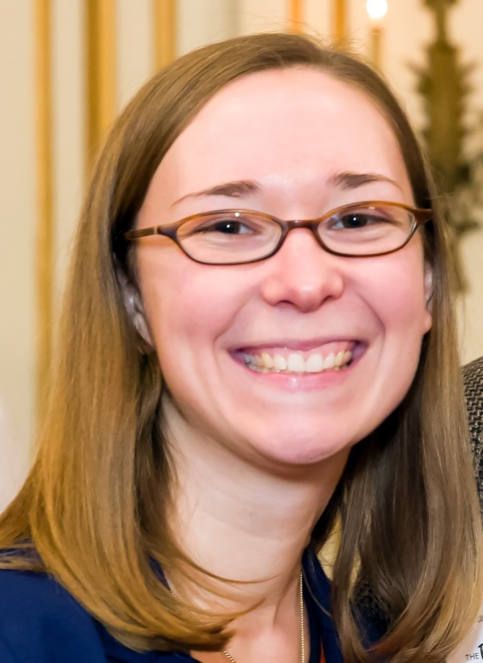
Introductions
ABOUT ME
JOB SEARCHING IS HARD. I MAKE IT LESS HARD.
Previously:
Career Program Manager at the Posse Foundation
Admissions officer at Brandeis University
History & East Asian Studies major at Harvard
Hello, world!
Julie Carroll, Outcomes Lead, Boston
julie.carroll@ga.co • www.linkedin.com/in/juliecarroll2
617-294-9022 • @JuliesTheBest
Notes:
Why I work at GA – I recently went through a job search.

Slide 5
Introductions
ABOUT YOU: SAY IT ON SLACK
Use the Outcomes channel
In <140 characters, share why you came to GA, and where you hope to go from here.
Example: “I was burnt out from years at the same accounting job. I want to learn to code and start a more exciting career as a developer.”

Slide 6
Introductions
ACTIVITY: COMMON GROUND
Please put your name plates away!
Find 1 person who has worked in the same industry as you.
Find 1 person who has faced a similar career challenge that you have faced (e.g. unemployment, career dissatisfaction, difficulty networking, etc.)
Find 1 person who shares your love for one of your favorite foods.
Remember everyone’s name and these answers!

Slide 7
What is outcomes?
GA OUTCOMES

Slide 8
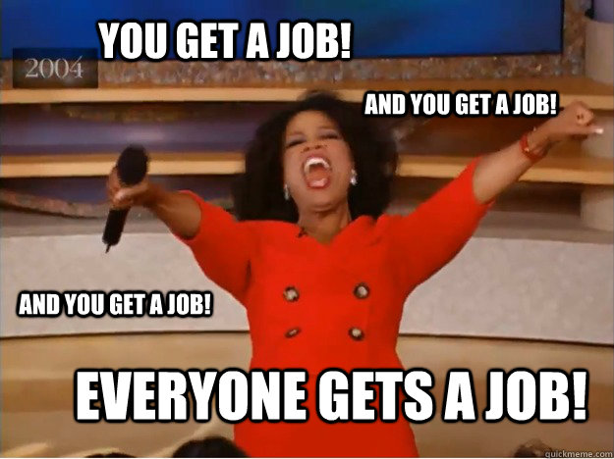
What is outcomes?

Slide 9
What is outcomes?
AM I GOING TO GET A JOB?
Five-finger check: How important is this question to you?
5 = super dee duper important

Slide 10
General Assembly Outcomes Benchmark
AM I going to Get a job?
99% of actively seeking GA immersive graduates achieve an outcome within 180 days of job searching
Boston’s track record is even higher
Five-finger check: How do you feel about GA’s Outcomes record?
5 = Fantastic and relaxed
1 = That’s nice but I’m definitely that 1%
Notes:
Definition of actively job seeking – you must want it – hustle, do the things we recommend. Types of people who do not fit this profile –
Graduate – you must graduate from the program
Web developer – you must want to be a web developer, not a technical PM, not a data scientist, not a project manager

Slide 11
WHAT IS OUTCOMES
WHAT IS CONSIDERED AN OUTCOME?
An outcome is a paid opportunity as a web developer, including: a full-time job, internship, or a full-time contract lasting at least one month.
GA tracks outcomes for immersive graduates who are qualified, active job-seekers.
*GA currently supports immersive graduates only through their first outcome.*

Slide 12
WHAT WE DO and WHAT WE DON’T DO
GA OUTCOMES

Slide 13




WHAT WE DO
Plus friendship!
Outcomes will make you more confident and capable in your job search.
You are in the driver’s seat.
…and some ass-kicking.

Slide 14
WHAT WE DO DO
What is “Outcomes Support”?
I check in with you.
I advise you.
I strategize with you.
I hold you accountable.
I recommend you to GA partners.

Slide 15
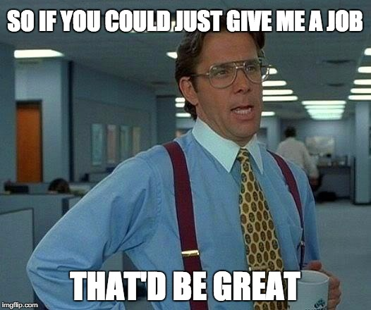
WHAT WE DON’T DO
We do not “get” you a job.
We do not take a hiring commission from companies that hire our grads.
We are not a job placement agency.

Slide 16
OUTCOMES PROGRAMMING
GA OUTCOMES

Slide 17
OUTCOMES OVERVIEW: EXAMPLE
WHAT IS OUTCOMES?
Week 1: Intro to Outcomes
Week 2: Intro to Industry + Market
Week 3: Personal Branding
Week 4: Evening Event/Panel
Week 5: Digital Presence
Week 6: Networking
Week 7: Catch-up Workshop
Week 8: Resumes + Portfolios
Week 9: Applying + Interviewing Strategies
Week 10: Whiteboarding or UX Portfolio Reviews
Week 11: GA Profiles
Week 12: What’s Next: Your Job Search
Post-Course*
Mock Interviews/Outcomes Day
Meet + Hire event
One-on-Ones and continued coaching
*If you have travel plans in the 3 weeks following graduation, let’s talk.

Slide 18
OUTCOMES programming
TOPIC
Deliverable
DIGITAL PRESENCE
LINKEDIN
NETWORKING
ELEVATOR PITCH
RESUMES + COVER LETTERS
New + Improved RESUME
INTERVIEW STRATEGY
MOCK INTERVIEWS
The JOB SEARCH
TreLLO tracking System

Slide 19
Meet & Hire
GA OUTCOMES

Slide 20
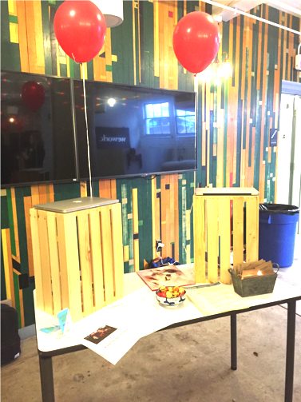
WHAT IS THE MEET & Hire?
Meet & HIRE
When: One evening 1-2 weeks after graduation
What: Reverse job fair
Who: You and your kick-ass projects + a lot of employers

Slide 21
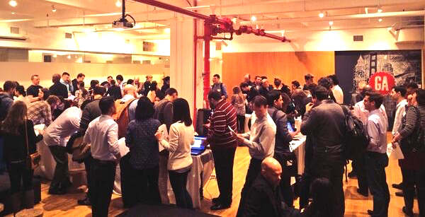
Meet & HIRE

Slide 22






meet & Hire
BOSTON Companies you might see at meet & Hires:
Boston.com
Cengage Learning
MeYou Health
America’s Test Kitchen
Kiksu
Arnold Worldwide
Hill Holliday
Kayak
Maxwell Health
Sapient Nitro
Wayfair
Ideo
LogMeIn
Forward Financing
Infrared5
Fidelity Labs
Plus: your dream employer?

Slide 23
Outcomes Expectations
GA OUTCOMES

Slide 24
Eligibility for Outcomes and M&H
Outcomes Expectations
You must graduate the GA program – that means homework average, quizzes, projects.
You must attend all Outcomes Programming both during and after the course.
You must complete all Outcomes assignments and surveys.
Why are we being such hard-asses? We want you to get a job! Pronto! #toughlove
Notes:
#TOUGH LOVE

Slide 25
OUTCOMES EXPECTATIONS
BECOMING A JOB SEEKER
In order to qualify for Outcomes support, you’ll need to complete the following AND begin your job search immediately after graduation (2 week cutoff).
resume
digital presence: LinkedIn &
GA PrOFILE
Online
portfolio
shareable way of tracking job search
(Trello)
participation in All Outcomes Programming
& Surveys

Slide 26
OUTCOMES EXPECTATIONS
REMAINING AN ACTIVE SEEKER
Job seekers must fulfill these requirements to receive continued Outcomes support. Job seekers must begin these responsibilities immediately after graduation (2 week cutoff).
10+ job applications/wk
networking (2+ events/month)
daily updating of job search tracker + responsiveness
continued study and application of skills
presence in preferred market
(Strongly encouraged)
*These are GA’s expectations globally. Boston’s expectations are higher.

Slide 27



WEEKLY JOB SEEKER EXPECTATIONS
FULL TIME SEEKER
PART TIME SEEKER
NOT SEEKING
ON HOLD
PER WEEK
25-40 HOURS
2+ NETWORKING EVENTS
2-3 NETWORKING 1:1s
10+ TARGETED APPLICATIONS
SKILL BUILDING
10-25 hours
1-2 NETWORKING EVENTS OR 1:1s
3-5 APPLICATIONS
<10 HOURS
SOME NETWORKING
OCCASIONAL APPLICATIONS
INCLUDES:
VACATION
FULL-TIME JOB
RePEATED BREAKS
FAMILY RESPONSIBILITY
*TOTAL DAYS ON HOLD MUST NOT EXCEED 30*
JOB SEEKERS MUST ADHERE TO THESE REQUIREMENTS TO RECEIVE CONTINUED OUTCOMES SUPPORT
TyPical OUTCOME
IN ~3 MONTHS
TYPICAL OUTCOME
IN ~6 MONTHS
TYPICAL OUTCOME
IN 6+ MONTHS
OUTCOME IN 1-3 MONTHS
OUTCOME IN 3-6 MONTHS
OUTCOME IN 6+ MONTHS
OUTCOME UNKNOWN
Notes:
This is what job seeking looks like from successful grads - best practices and trends
Outcomes supports those who do the work
The more you do, the more we do
Be thoughtful and honest about your search, think about it and then let us know…

Slide 28

OUTCOMES EXPECTATIONS
FAILURE TO MEET JOB-SEEKER EXPECTATIONS WILL RESULT IN EXCLUSION FROM OUTCOMES SUPPORT.

Slide 29
OUTCOMES EXPECTATIONS
TEAM CONTRACT
What can you expect from Julie?
What can Julie expect from you?
What can you expect from yourself?
What can you expect from your colleagues?
Notes:
Gallery Walk activity – notes around the room

Slide 30
Final Thoughts
GA OUTCOMES

Slide 31
ReLAx. WE’re in this together.
Final ThougHts
#friendship

Slide 32
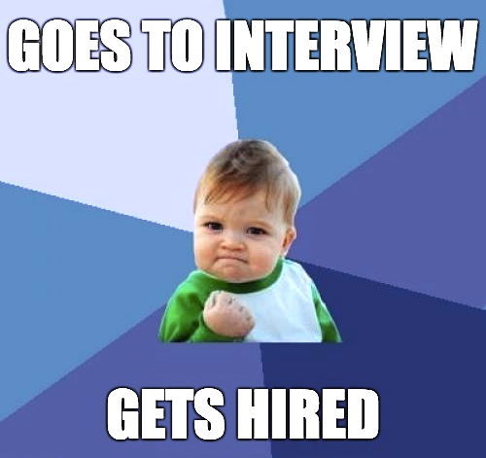
NEXT STEPS…
Final ThougHts
Outcomes Google Drive folder
Assignment: In the Google spreadsheet that Julie shared with you, write down:
What is your Outcomes goal when you complete this course?
What challenges will you face achieving that goal?
Assignments in Google doc due before next Outcomes workshop.

Slide 33
Q&A
GA OUTCOMES
Exit ticket: https://ga-research.typeform.com/to/tKqUa1

